Slide 1
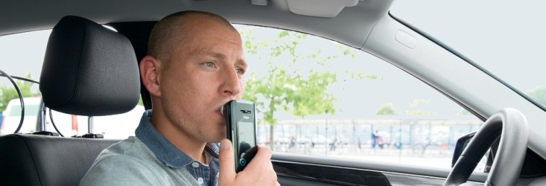
Dräger Interlock® 7000
BUS COMPANY

Slide 2
Dräger Interlock® 7000 Why Dräger?
For more than 60 years, Dräger has been a world market leader in breath alcohol measurement
Our alcohol ignition interlock devices have been successfully established for more than two decades
01
World market leader in breath alcohol technology
02
Precise
and reliable measurement
The Interlock devices use our proven Dräger Alcotest® sensor technology
The Dräger Alcotest® devices are used by the police in many countries for traffic control
The Interlock 7000 is able to identify mouth alcohol
03
Safe data handling
The Interlock 7000 provides seamless data
Latest technology standards guarantee full data security
From capture to provision, the data is protected against manipulation attempts
< 4
seconds until the Interlock 7000 is ready for testing
60%
market share in the European
Interlock business
< 1
mA power consumption in stand-by mode of the Interlock 7000
60
years of experience in breath alcohol measurement

Slide 3
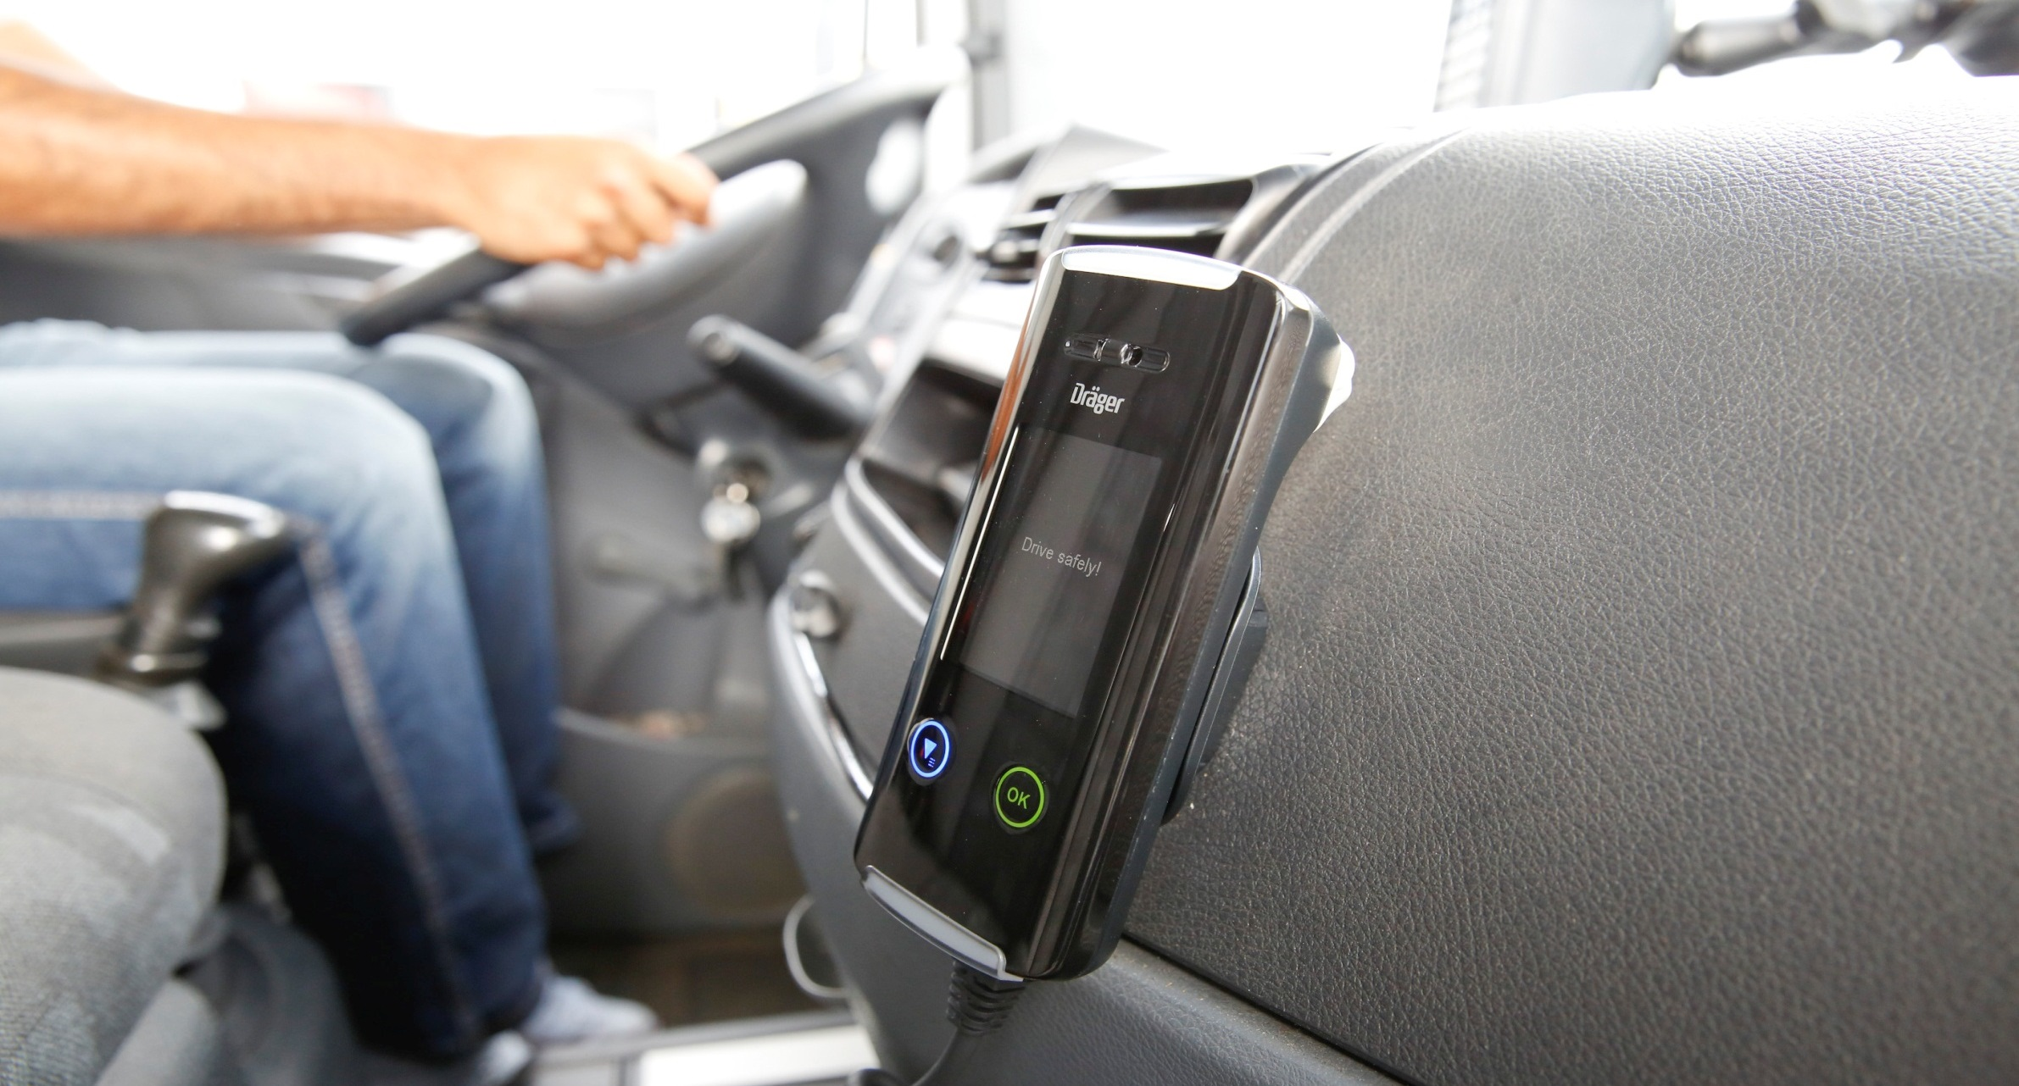
Dräger Interlock® 7000 Application Scenarios
Challenge: Reliable alcohol measurement for more safety
A bus driver or a driver transporting hazardous goods is responsible for his/her own life and for public safety. An alcohol measuring instrument with vehicle immobilizer helps to protect staff, passengers and goods reliably from the risks of drunk-driving. Therefore, you need a device ready to use quickly and operate with low power consumption.
Passenger and goods transportation
1
Commercial vehicles at the workplace
2
Offender programs
3
Solution: Interlock 7000

Slide 4
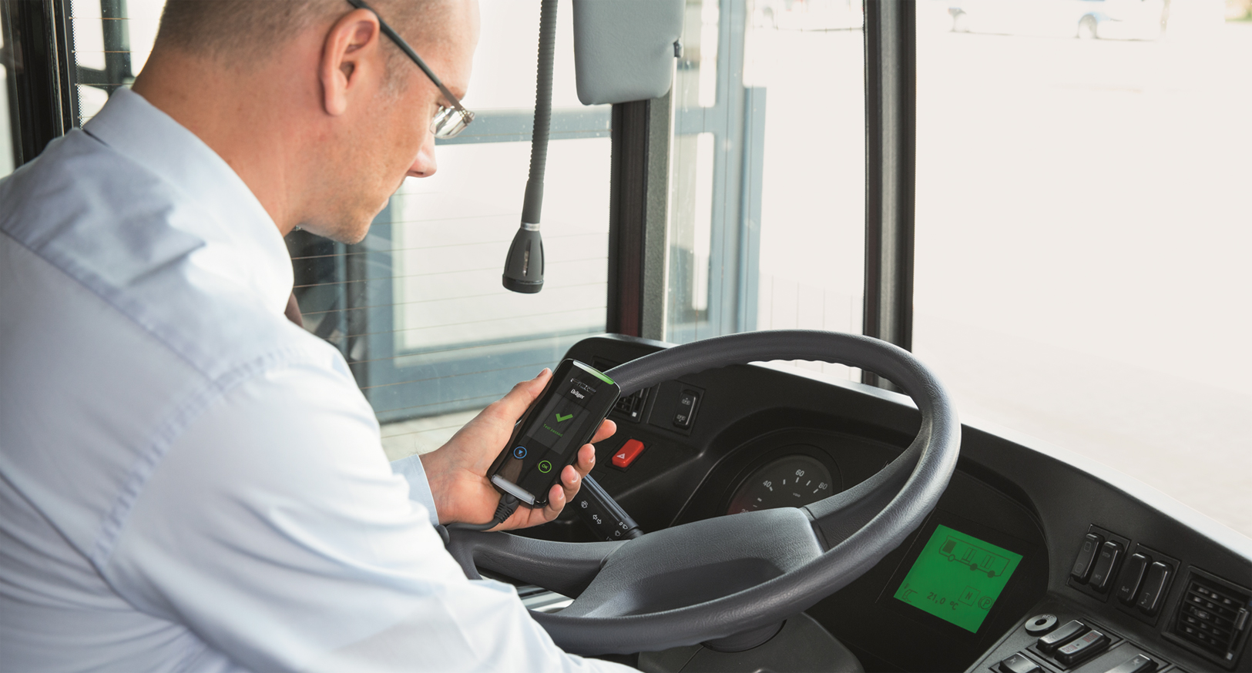
Dräger Interlock® 7000 Application Scenarios
Challenge: Reliable alcohol measurement for more safety
Everyday, workers in mines, construction sites and other workplaces use heavy and large vehicles like mining vehicles, cranes, light trucks or fork lifts. While using these vehicles, it is especially important to reduce alcohol-related accident risks and risks due to residual alcohol.
Passenger and goods transportation
1
Commercial vehicles at the workplace
2
Offender programs
3
Solution: Interlock 7000

Slide 5
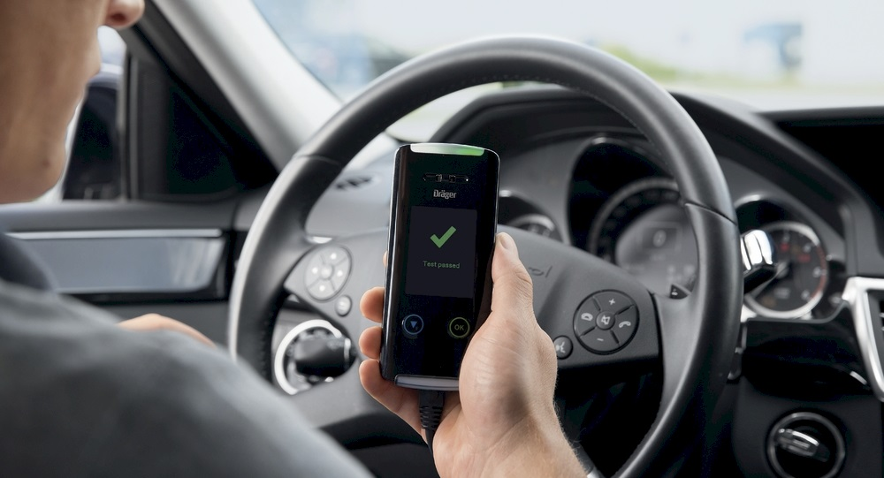
Dräger Interlock® 7000 Application Scenarios
Challenge: Reliable alcohol measurement for more safety
A safe start into road traffic can be increased by an alcohol ignition interlock device used within legally required drunk-driving offender programs. The device should provide reliable and precise results due to state-of-the-art technology. It should also facilitate the daily data handling of the responsible authorities. All stored data should be tamper-proofed.
Passenger and goods transportation
1
Commercial vehicles at the workplace
2
Offender programs
3
Solution: Interlock 7000

Slide 6
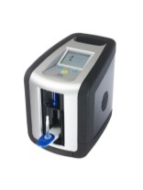
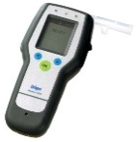
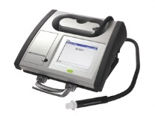
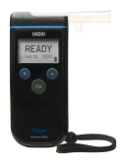
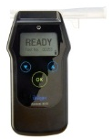
Dräger Interlock® 7000 Extended Portfolio
Extended portfolio Alcohol and drug detection
The products of the Dräger Interlock® and Dräger Alcotest® family specifically measure alcohol. The drug detection devices are based on oral fluid screening. The measuring results are reliable and precise.
With our alcohol and drug detection devices you benefit from the results of our extensive experience.
For more than 60 years Dräger has been a recognized reference
for breath alcohol measurements in the police sector.
Dräger DrugTest® Drug testing devices
Dräger Alcotest® Screening and evidential alcohol measuring devices
Dräger Interlock® Alcohol measuring devices with vehicle immobilizer

Slide 7
Dräger Interlock® 7000 Technical Data
Short warm-up time | < 4 seconds above 0 °C (32 °F) < 60 seconds at -20 °C (-4 °F ) < 110 seconds at -40 °C (-40 °F )
Wide temperature range | Approved temperature range of -45 °C to 85 °C (-49 °F to 185 °F)
Advanced data handling | From creation to provision: Special encryption methods for data protection
Highest data security | Data protection against manipulation attempts, all data is encrypted
Authorized data access | Data access for authorized personnel only
Reliable results | Proven Alcotest® sensor technology
Camera (optional) | Recording of images of submitted breath samples
Data readout | Infrared, Bluetooth
Safety
Cost efficiency
Produc- tivity
Short warm-up-time
for cost and time
effective testing
€
Wide temperature
range for use under
different climate
conditions
€
Reliable results
due to proven
technology
€
Safety due to
good image quality,
no matter if it is day or night
Fast and flexible
data readout
<

Slide 8
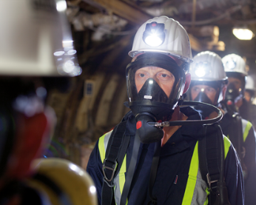
Dräger Interlock® 7000 Markets we are in
Mining
Police
Hospital
Oil & Gas
xxx
Logistics
Public transportation
Private use
Mining

